Slide 1
RocksDB Festival
Supported by IITP, StarLab.
August 2, 2021
송인호, 한예진
inhoinno@dankook.ac.kr , hbb97225@naver.com
TeamName : 멘탈모델을 만들고 싶어요

Slide 2
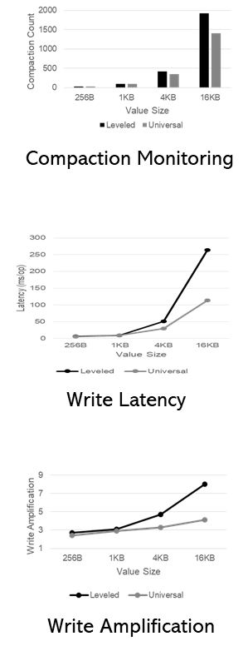
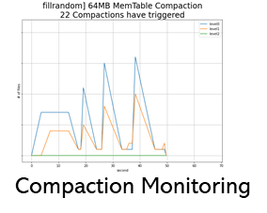
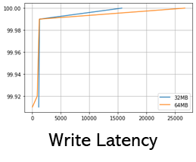
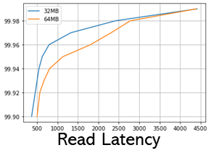
Contents
Last Week
Leveled vs Universal Compaction Comparison
Block cache size – Hit ratio
Write-Ahead-Log – Throughput, Latency
This Week
관련 논문 조사
2

Slide 3
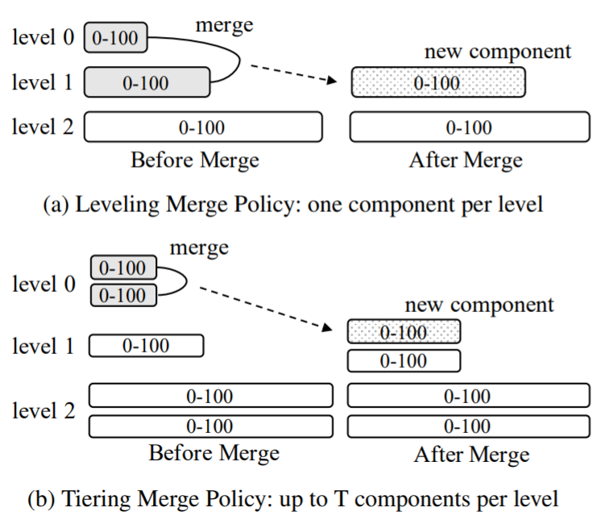
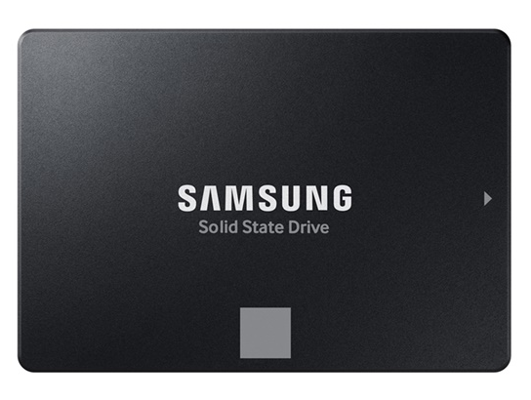
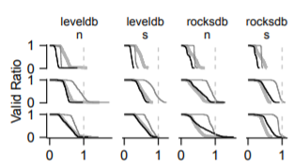
Plan
SSD에 Random Write Pattern을 보이는 Compaction을 Catch할 계획
Level Compaction
Universal Compaction
Fig: Luo, Chen, and Michael J. Carey. "LSM-based storage techniques: a survey." The VLDB Journal 29.1 (2020): 393-418.
RocksDB LVL
RocksDB UNIV
Cumulative Block Space
A zombie curve shows the sorted non-zero valid ratios of blocks
Jun He, Sudarsun Kannan, Andrea C. Arpaci-Dusseau, Remzi H. Arpaci-Dusseau, The Unwritten Contract of Solid State Drives, EuroSys '17
https://github.com/junhe/wiscsee

Slide 4

Discussion

Slide 5
Last Week

Slide 6
Compaction Style
Leveled Compaction, Universal Compaction
Sorted Level vs Sorted Run
Example of LeveledCompaction
Example of Universal Compaction
level
level
0
1
2
0
1
2
0
1
2
7
insert 13
0
1
2
0
1
2
0
1
2
7
insert 13
1 3
10 19
Flush &
merge
3 19
1 10
2 4 8 12 15 18
2 4 8 12 15 18
flush
move
merge &
move
1 3
7 10 13 19
3 19
1 10
7 13
2 4 8 12 15 18
2 4 8 12 15 18
merge
1 2 3 4 7 8
10 12 13 15 18 19
2 4 8 12 15 18
1 3 7 10 13 19

Slide 7

Mental Model
RocksDB
레벨 컴팩션의 문제점을
유니버셜 컴팩션의 “__“
으로
완화할 수 있다

Slide 8
LVL vs Univ Compaction Comparison
WAL
Block cache size
CAUSE
EFFECT
EFFECT
Leveled
Compaction
Throughput
WAF
Universal
Compaction
Latency
Compaction #

Slide 9
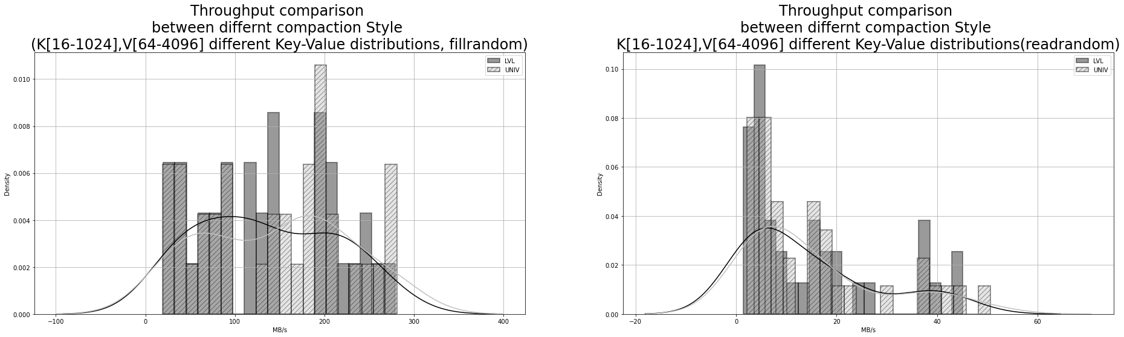
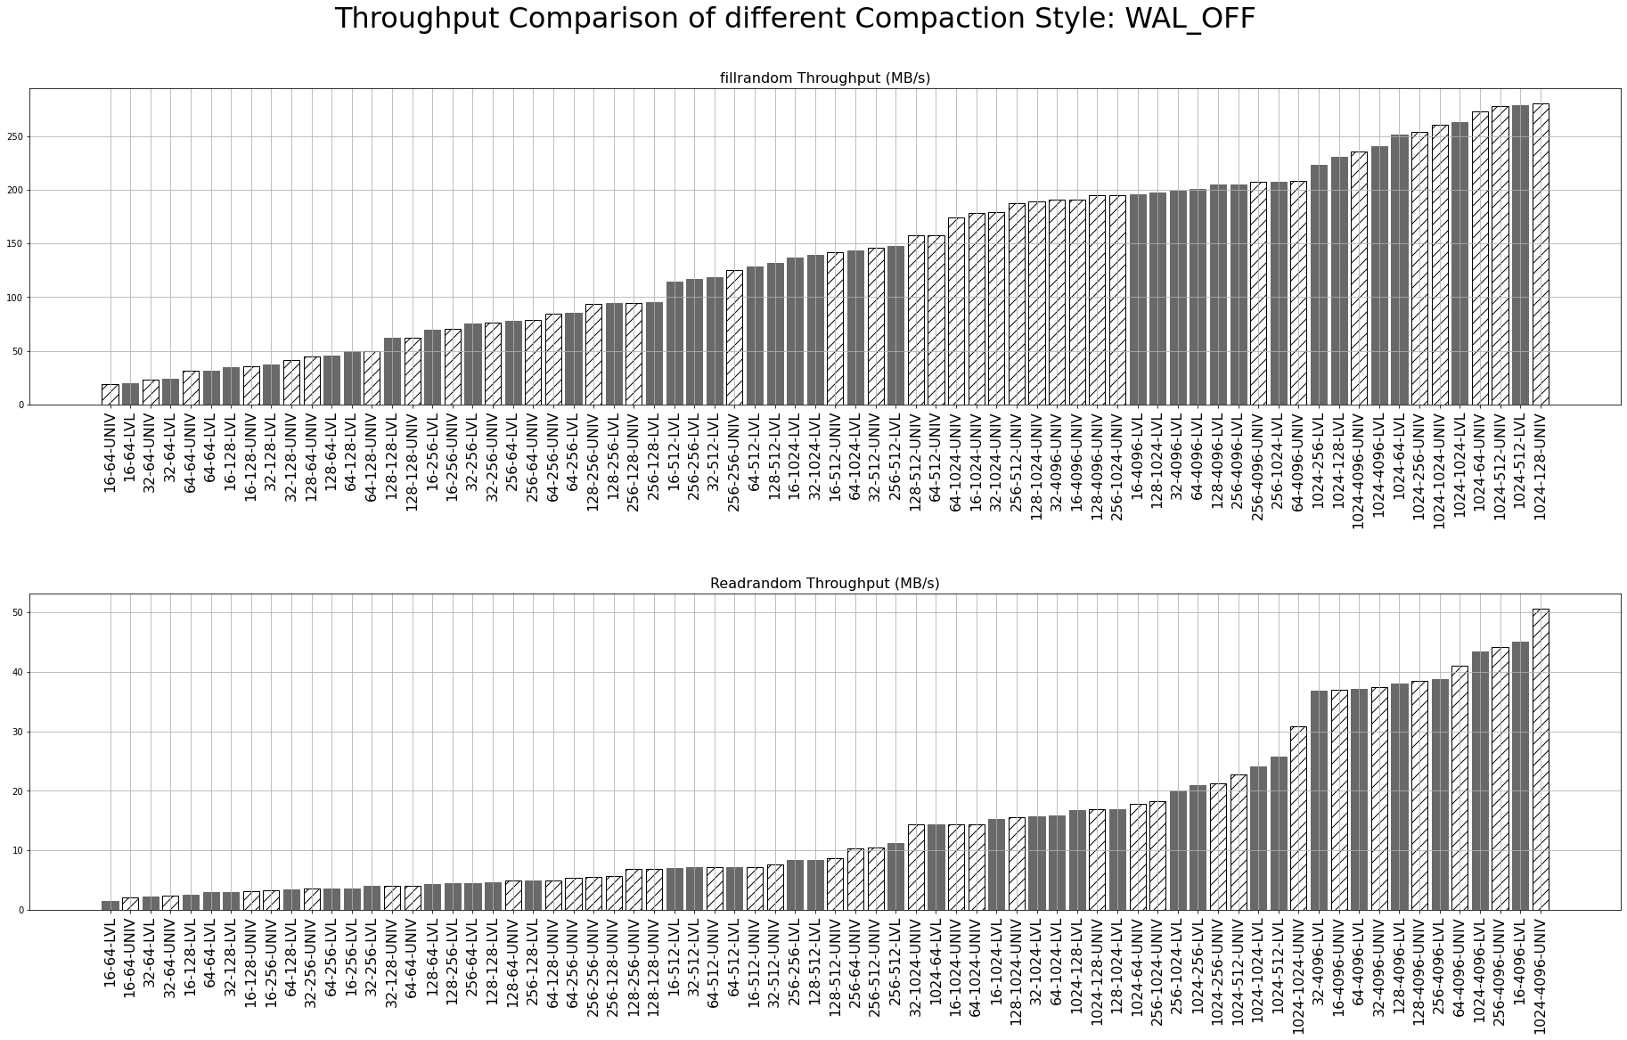
LVL vs Univ Write Throughput: WAL_OFF
Fillrandom
Key [16, 32, 64, 128, 256, 1024]
Value [64, 128, 256, 512, 1024, 4096]
DB_Size 2.4GB
Storage Samsung 512GB 860 Pro
File System Ext4
CPU Intel(R) Core(TM) i5-4440 CPU @ 3.10GHz
Right is better
MB/s
LVL Compaction
Univ Compaction
MB/s

Slide 10
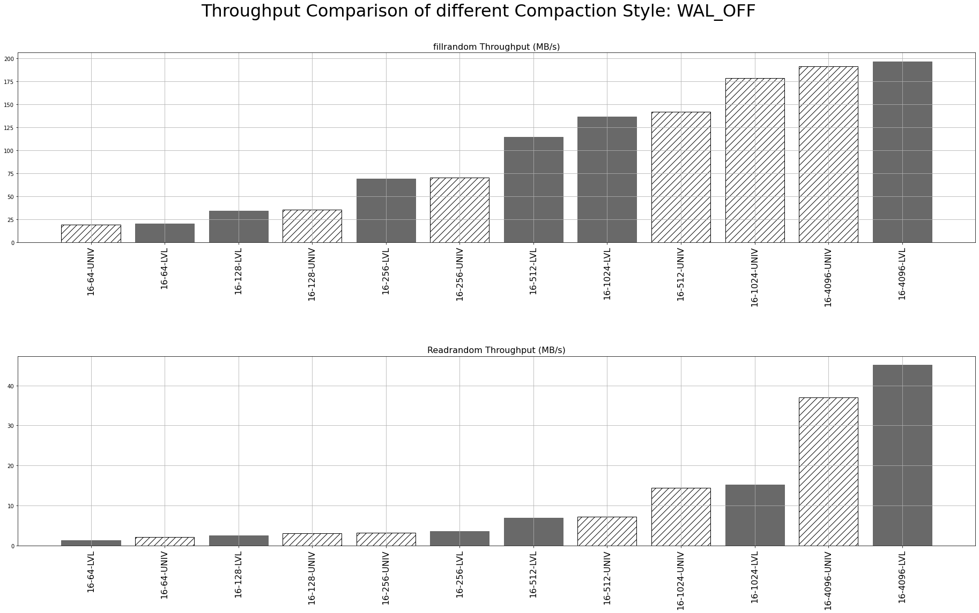
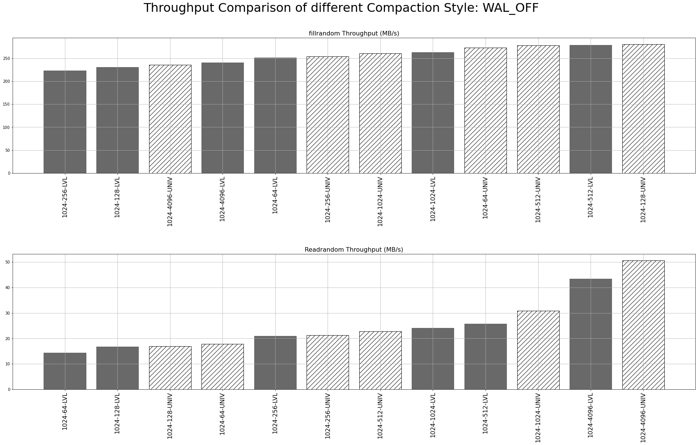
LVL vs Univ Write Throughput: WAL_OFF
Write Throughput: WAL_OFF - K16, 1024 / V[64-4096]
LVL Compaction
Univ Compaction

Slide 11
LVL vs Univ Read Throughput: WAL_OFF
Readrandom
--use_existing_db
Key [16, 32, 64, 128, 256, 1024]
Value [64, 128, 256, 512, 1024, 4096]
DB_Size 2.4GB
Storage Samsung 512GB 860 Pro
File System Ext4
CPU Intel(R) Core(TM) i5-4440 CPU @ 3.10GHz
Right is better
MB/s
LVL Compaction
Univ Compaction
MB/s

Slide 12
LVL vs Univ Read Throughput: WAL_OFF
Read Throughput: WAL_OFF - K16, 1024 / V[64-4096]
LVL Compaction
Univ Compaction

Slide 13
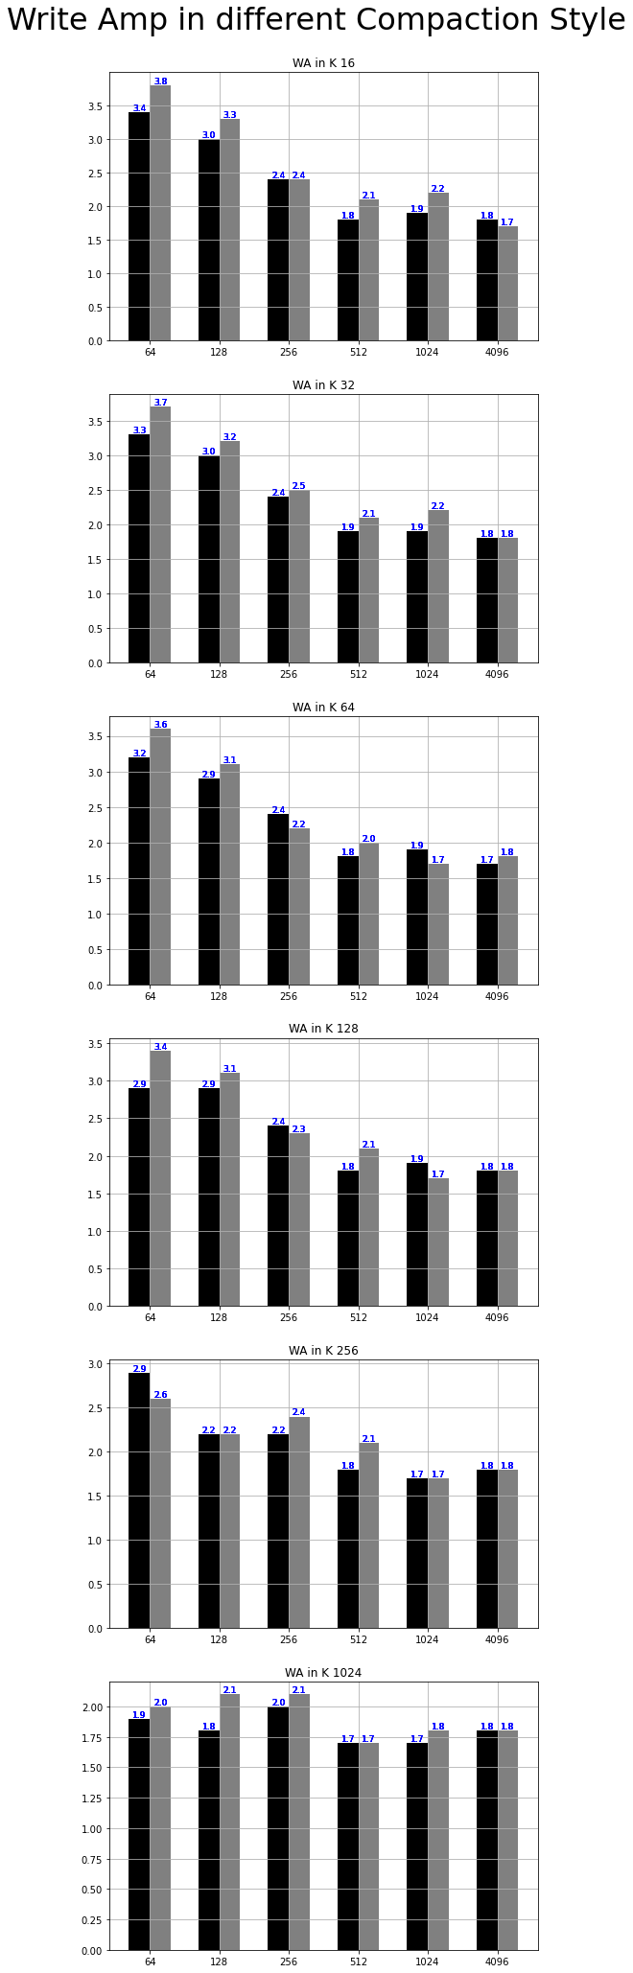
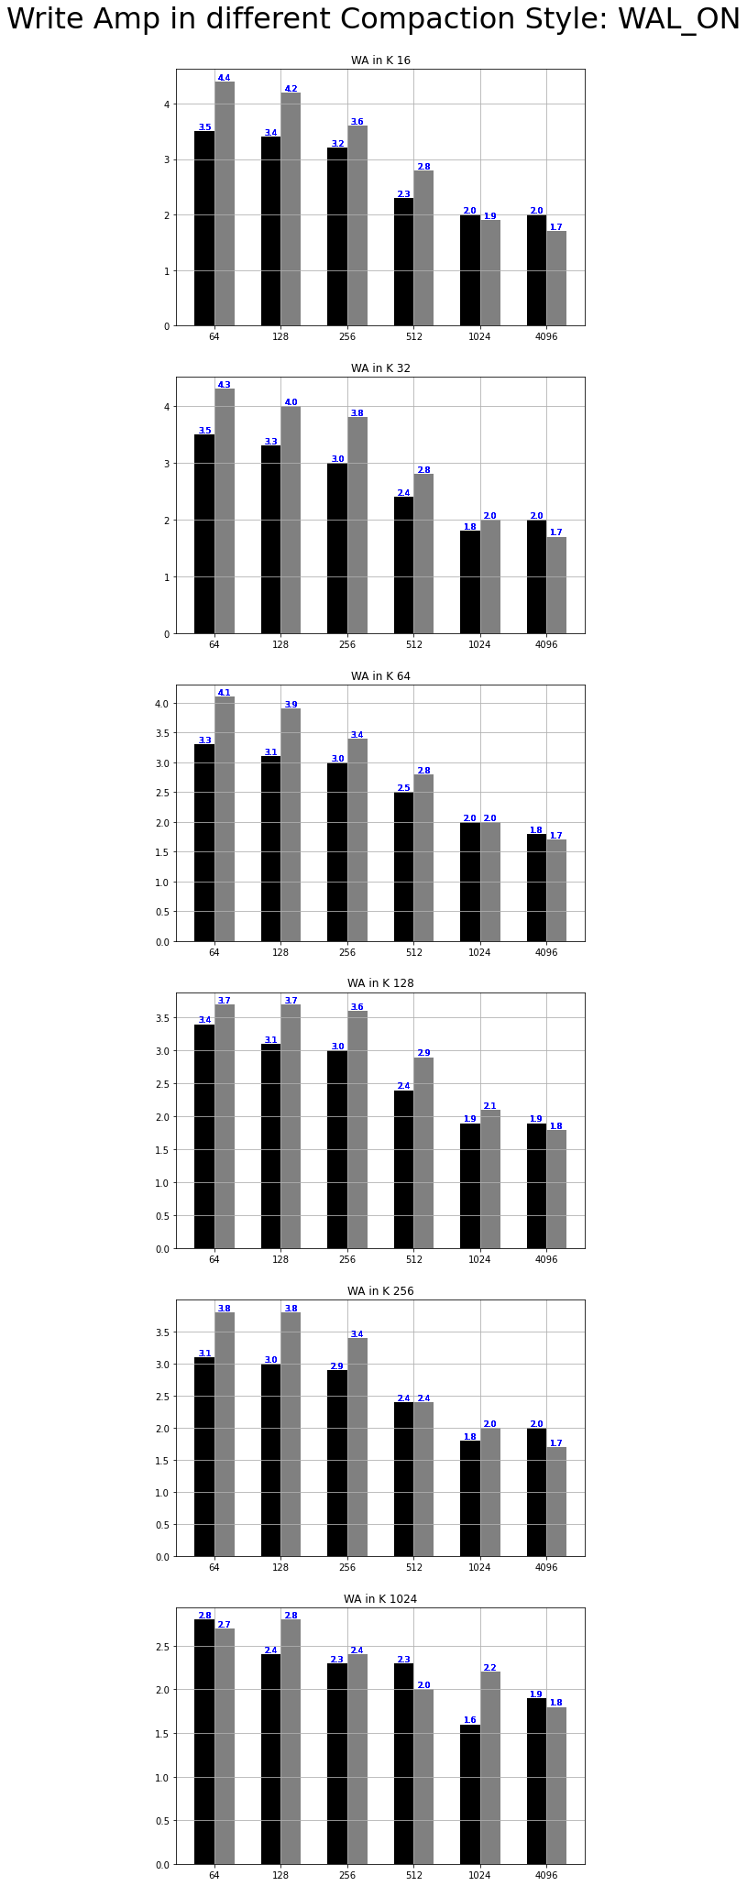
LVL vs Univ WAF Comparison:WAL_OFF
WAF: WAL_OFF
WAF: WAL_ON
LVL Compaction
Univ Compaction
LVL Compaction
Univ Compaction
LVL Compaction
Univ Compaction
LVL Compaction
Univ Compaction

Slide 14
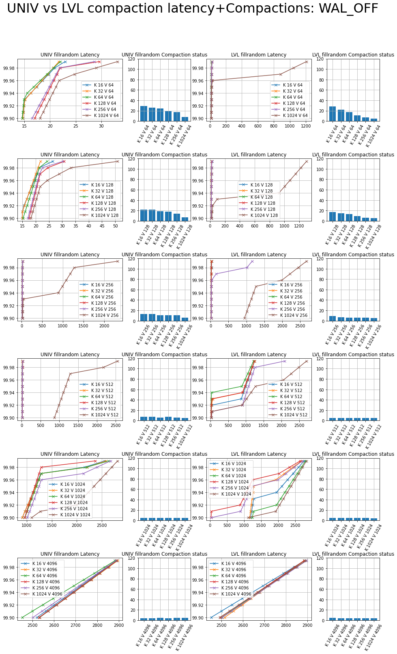
LVL vs Univ # of Compactions , latency Comparison
Fillrandom latency 99.99%: WAL_OFF

Slide 15
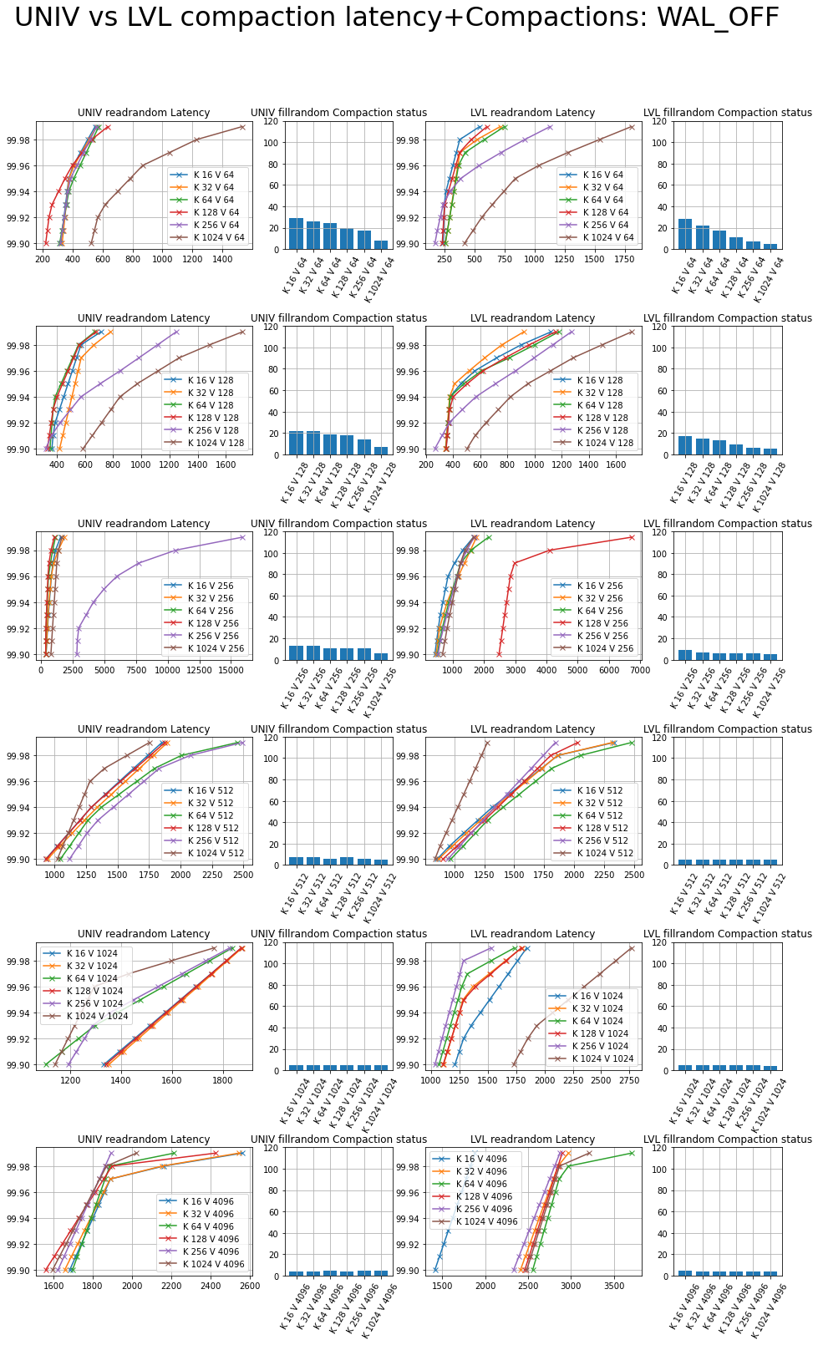
LVL vs Univ # of Compactions , latency Comparison
Readrandom latency 99.99%: WAL_OFF

Slide 16
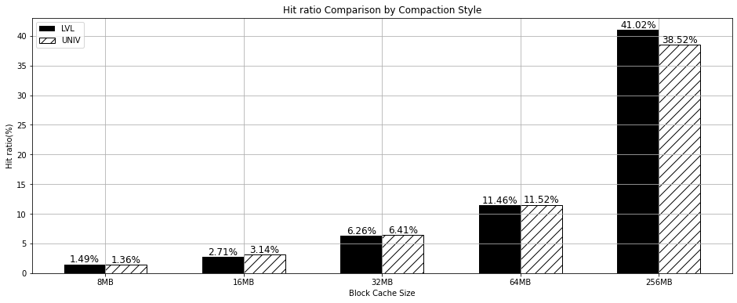
LVL vs Univ Cache Hit ratio Comparison
Block Cache Hit ratio Comparison
8MB, 16MB, 32MB, 64MB, 256MB → 512MB, 1GB, 2GB, 4GB 실험 중..
Default
☞ Hit ratio is less than 50% under block cache size == 256MB

Slide 17
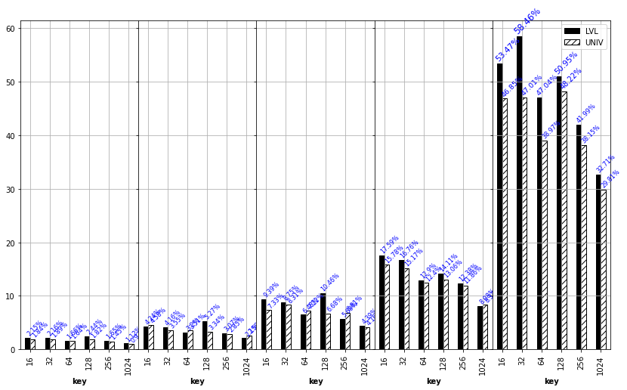
LVL vs Univ Cache Hit ratio Comparison
Block Cache Hit ratio Comparison

Slide 18
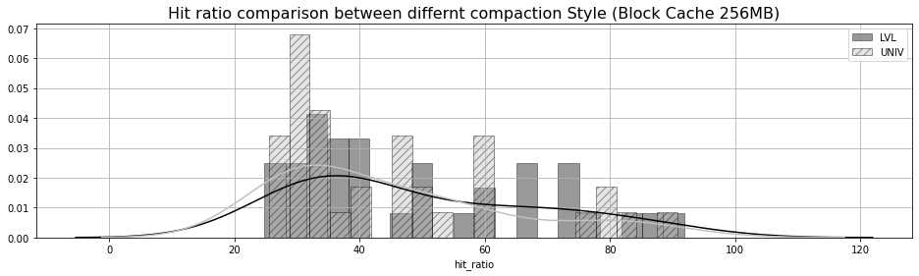
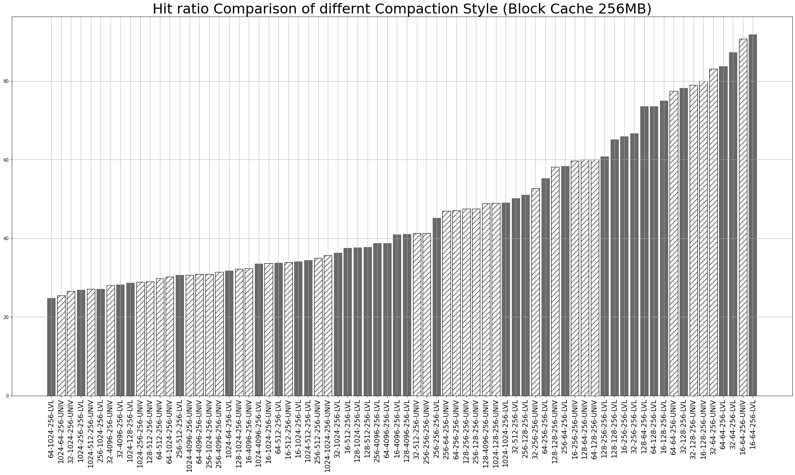
LVL vs Univ Cache Hit ratio Comparison
Readrandom
--use_existing_db
Key [16, 32, 64, 128, 256, 1024]
Value [64, 128, 256, 512, 1024, 4096]
Entries 500 0000
Storage Samsung 512GB 860 Pro
File System Ext4
CPU Intel(R) Core(TM) i5-4440 CPU @ 3.10GHz
Left is better
16k-64v-256MB-UNIV: 90.79%
16k-64v-256MB-LVL: 91.83%

Slide 19
Mental Model
Quantative Experiment
LvL vs Univ
KV distribution
Throughput, latency, Hit ratio, QPS(queries per second)
SST Table Size
Throughput, latency
WAL off
Adjusting block cache size
Qualitative Experiment
Level Compaction’s weak point
Write Amplification
Write Stall
Methods to overcome
Universal Compaction’s weak point
Read Amplification
Space Amplification
Methods to overcome
→ New Idea!
1~2 Week
1~2 Week

Slide 20
Mental Model
Level Compaction
Universal Compaction
Fig: Luo, Chen, and Michael J. Carey. "LSM-based storage techniques: a survey." The VLDB Journal 29.1 (2020): 393-418.
RocksDB LVL
RocksDB UNIV
Cumulative Block Space
A zombie curve shows the sorted non-zero valid ratios of blocks
Jun He, Sudarsun Kannan, Andrea C. Arpaci-Dusseau, Remzi H. Arpaci-Dusseau, The Unwritten Contract of Solid State Drives, EuroSys '17
https://github.com/junhe/wiscsee

Slide 21
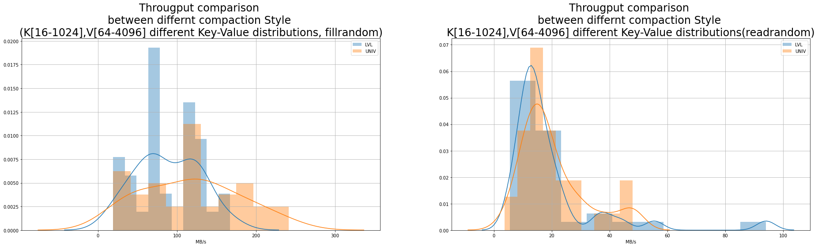
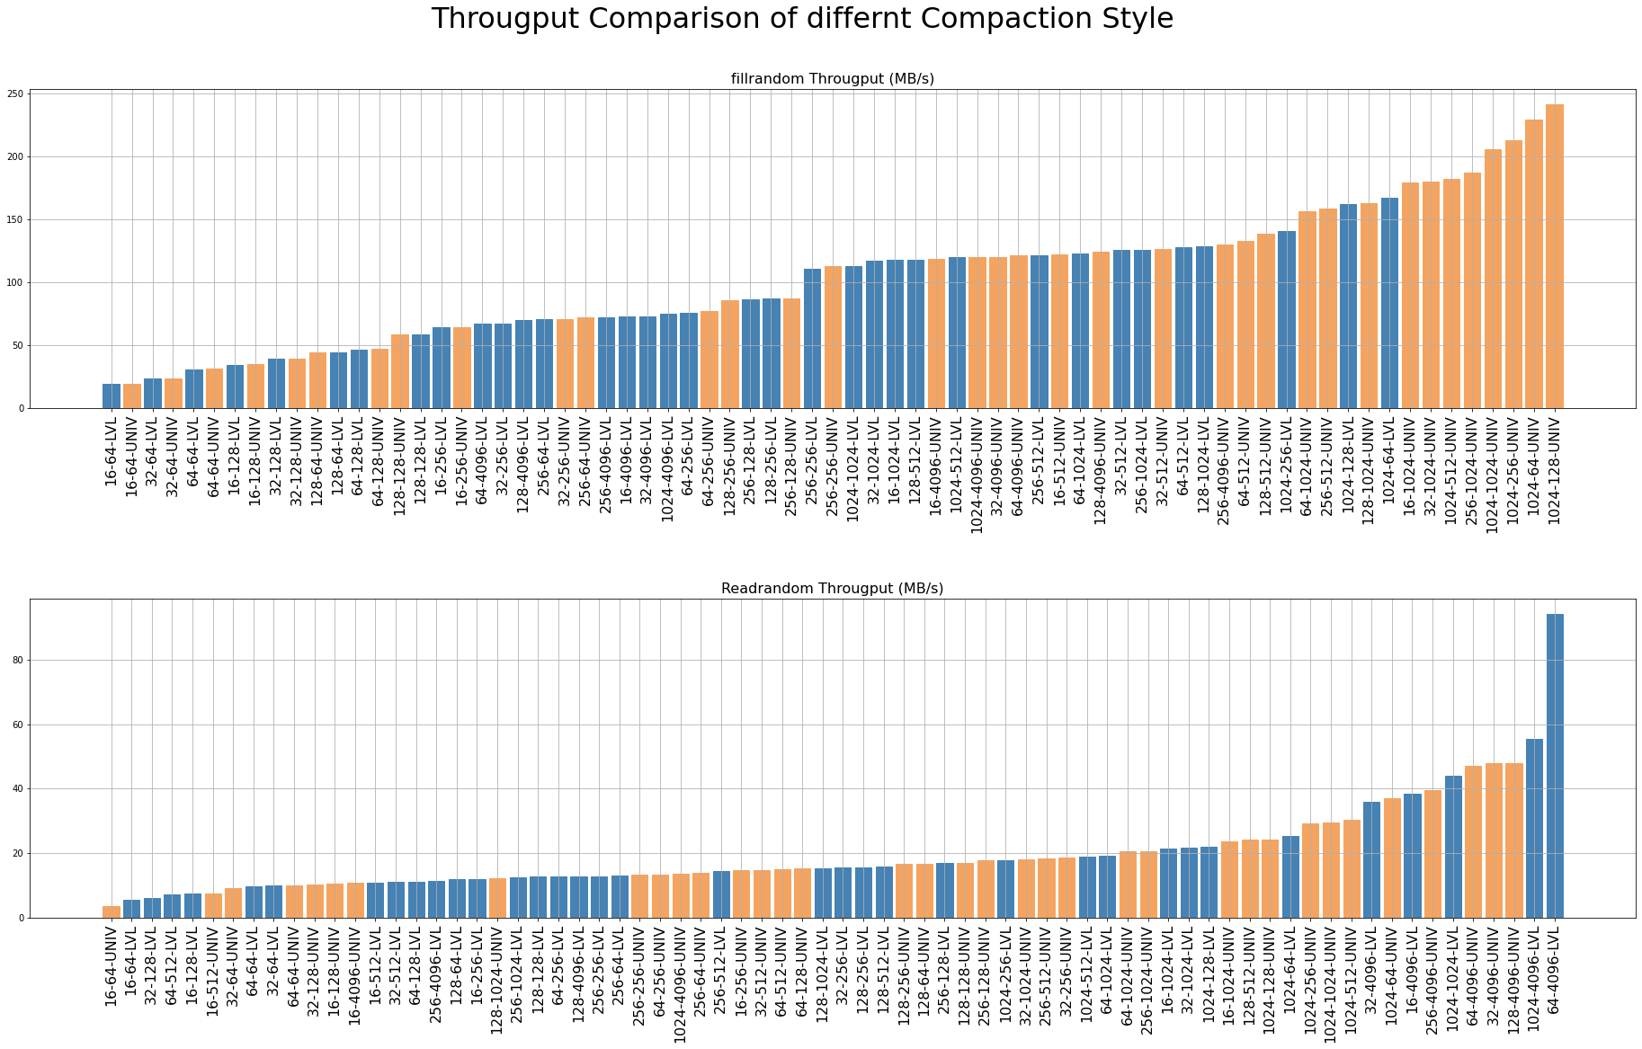
LVL vs Univ Throughput Comparison
Fillrandom
Key [16, 32, 64, 128, 256, 1024]
Value [64, 128, 256, 512, 1024, 4096]
Entries 500 0000
Storage Samsung 1TB 860 Pro
File System Ext4
CPU Intel(R) Core(TM) i7-10700K CPU @ 3.80GHz
LVL Compaction
Univ Compaction
Left is better
LVL Compaction
Univ Compaction
MB/s

Slide 22
LVL vs Univ Throughput Comparison
Readrandom
--use_existing_db
Key [16, 32, 64, 128, 256, 1024]
Value [64, 128, 256, 512, 1024, 4096]
Entries 500 0000
Storage Samsung 1TB 860 Pro
File System Ext4
CPU Intel(R) Core(TM) i7-10700K CPU @ 3.80GHz
LVL Compaction
Univ Compaction
Left is better
LVL Compaction
Univ Compaction
hard to define
what it is…
MB/s

Slide 23
LVL vs Univ Throughput Comparison
Optimal Key Size
Readrandom
--use_existing_db
Key [16, 32, 64, 128, 256, 1024]
Value [64, 128, 256, 512, 1024, 4096]
Entries 500 0000
Storage Samsung 1TB 860 Pro
File System Ext4
CPU Intel(R) Core(TM) i7-10700K CPU @ 3.80GHz
LVL Compaction
Univ Compaction
1/time
Left is better
MB/s
LVL Compaction
Univ Compaction
MB/s
☞ 마치 Value Size에 맞는 Optimal Key Size가 있는 것 처럼 보인다

Slide 24
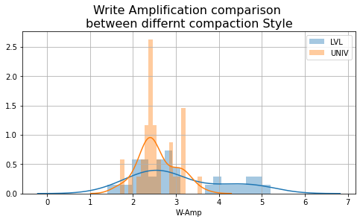
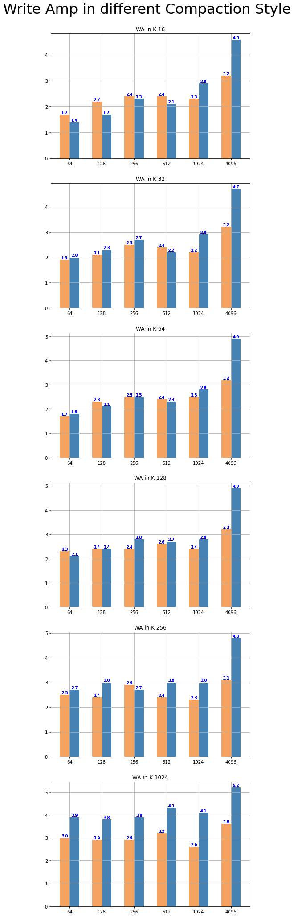
LVL vs Univ WAF Comparison
LVL Compaction
Univ Compaction
LVL Compaction
Univ Compaction
LVL Compaction
Univ Compaction

Slide 25
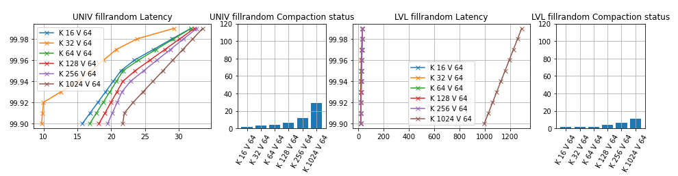
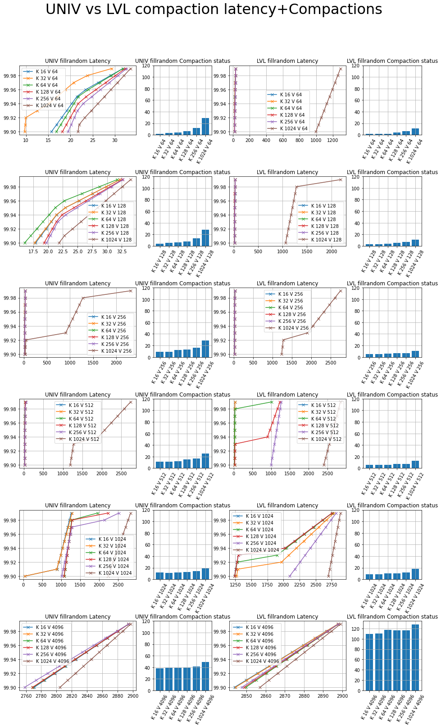
LVL vs Univ # of Compactions , latency Comparison
Fillrandom

Slide 26
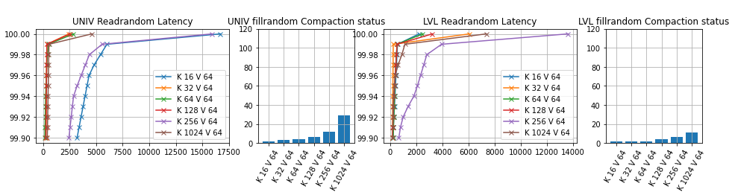
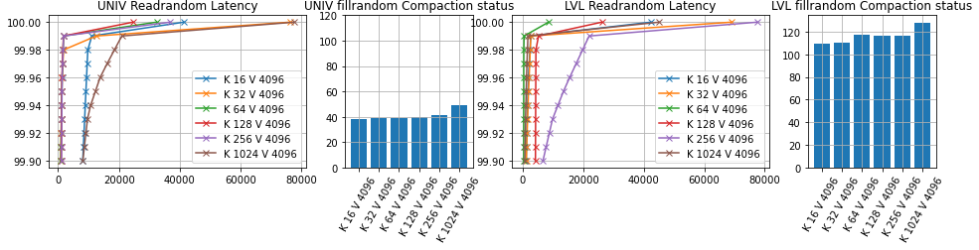
LVL vs Univ # of Compactions / latency Comparison
Readrandom

Slide 27
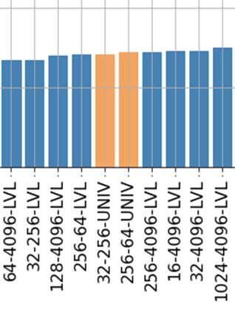
Issue on Last week
Throughput(KOPS)
Throughput(MB/s)
☞ 한 쪽은 OPS, 한 쪽은 MB/s 임.
즉, KV Size가 늘어날 수록 MB/s는 늘어나고, OPS는 줄어들게 됨

